Slide 1
E-WATER MANAGEMENT SYSTEM (EWMS)
WASAC — Water and Sanitation Corporation, Kigali, Rwanda
Phase 1 — System Analysis and Design
Student: Alvin MUNYAMBO Student Id: 27146 | Instructor: RUTARINDWA JEAN PIERRE
Course: Best Programming Practices and Design Patterns | AUCA 2025–2026

Slide 2
1.1
Topic and Case Study
TOPIC
E-Water Management System (EWMS)
CASE STUDY
WASAC — Water and Sanitation Corporation, Kigali, Rwanda
WASAC is Rwanda's national water utility. It produces, treats, and distributes clean water to millions of households and businesses. The EWMS was built to fully digitize WASAC's operations — replacing paper forms, manual billing, and in-person payments with a modern web-based digital platform.

Slide 3
1.2
Functional Diagram — Internal Working of WASAC
Field Dept
Billing Dept
Finance Dept
Customer Svc
• Read meters monthly
• Record usage (litres)
• Report meter issues
• Generate monthly bills
• Send invoices to clients
• Track overdue accounts
• Collect MoMo payments
• Reconcile accounts
• Revenue reporting
• Handle client queries
• Manage activations
• Process complaints
EWMS — Centralized Digital Platform
Admin Portal (localhost:8090) | Node.js REST API (:5000) | MongoDB Database
Add clients • Record readings • Generate bills • Process payments • View dashboards • Suspend accounts

Slide 4
1.3
Problem Statement — 6 Challenges Faced by WASAC
1. Manual Meter Readings
4. No Client Self-Service
Paper forms cause transcription errors and lost data
Customers queue at office for every simple query
2. Paper-Based Billing
5. Manual Disconnections
6 to 8 week cycles causing disputes and late invoices
Paper memos cause slow suspension and reconnection
3. No Real-Time Payments
6. No Analytics Dashboard
MoMo reconciled manually causing accounting errors
Management has no real-time visibility into revenue

Slide 5
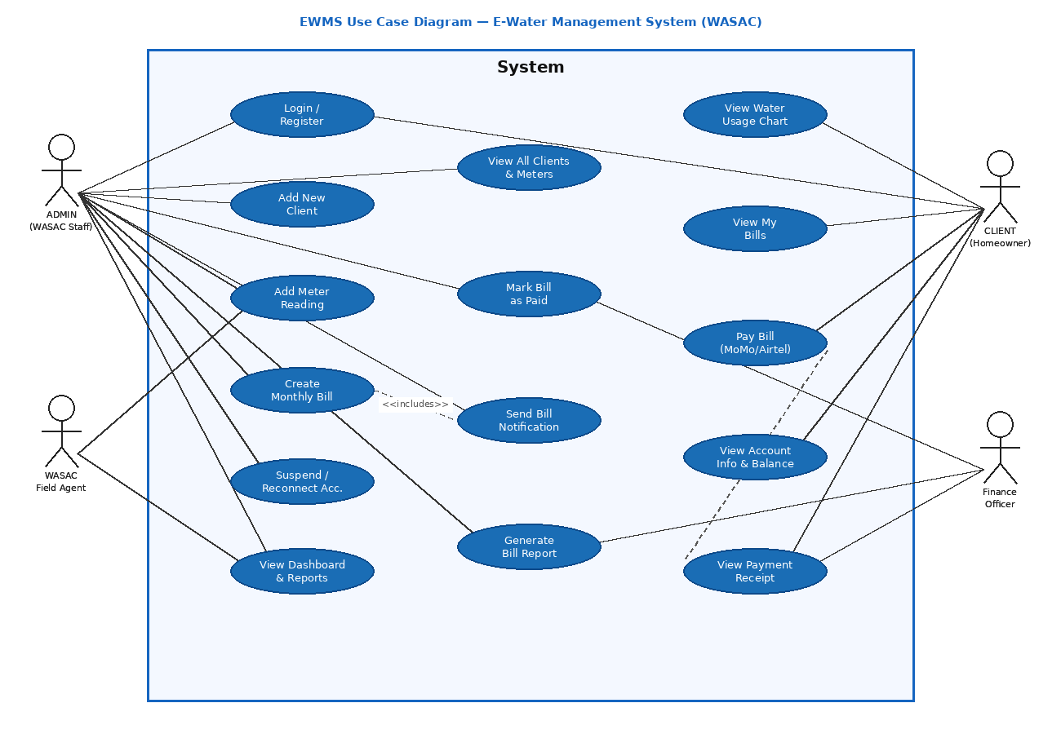
1.4.1
Use Case Diagram

Slide 6
1.4.1
Use Case Diagram — Actors and Connections
ADMIN + Field Agent
CLIENT + Finance Officer
• Login / Register
• Add New Client
• Add Meter Reading
• Create Monthly Bill
• View All Clients, Bills, Meters
• Mark Bill as Paid
• Suspend / Reconnect Account
• View Dashboard Stats
• Login / Register
• View Water Usage Chart
• View My Bills
• Pay Bill (MTN MoMo / Airtel)
• View Account Info & Balance
• View Payment Receipt
• Generate Bill Report (Finance)
<<include>>: Create Bill always triggers Send Notification | <<extend>>: Pay Bill optionally triggers Send Receipt

Slide 7
1.4.2
Class Diagram — 5 Core Data Models
USER
ADMIN
- _id:ObjectId
- name:String
- email:String
- phone:String
- passwordHash:String
- meterId:String
- isActive:Boolean
- isVerified:Boolean
- _id:ObjectId
- name:String
- email:String
- passwordHash:String
- role:String
+ comparePassword()
+ login():JWT
BILL
+ comparePassword()
+ register()
+ login():JWT
- _id:ObjectId
- userId:ObjectId
- meterId:String
- amount:Number(RWF)
- month:String
- year:Number
- dueDate:Date
- status:Enum
1 owns 1
PAYMENT
METER
1 triggers 1
1..*
- _id:ObjectId
- userId:ObjectId
- billId:ObjectId
- amount:Number
- method:momo|airtel
- phone:String
- status:Enum
- reference:String
- _id:ObjectId
- meterId:String
- userId:ObjectId
- isActive:Boolean
- balance:Number
- monthlyUsage:Array
+ generateBill()
+ markPaid()
+ getUsageHistory()
+ updateReading()
+ processPayment()
+ getReference()

Slide 8
1.4.3
Activity Diagram — Bill Payment Flow
Show EWMS
ref. number
Open EWMS
Portal
Bill status
→ PAID
Enter email
& password
NO
Valid
credentials?
API creates
Payment record
Load dashboard
& bills
Invalid
login
NO
Has unpaid
bill?
YES
Show bill
amount & date
Select MoMo
or Airtel
Enter phone
& Pay Now
No pending
bills!

Slide 9
1.4.4
Sequence Diagram — Admin Creates Monthly Bill
Admin
Browser
Frontend
JS
Node.js
API
MongoDB
1. Open Bills page
2. GET /admin/bills + JWT
3. Bill.find()
4. [{bills}]
5. 200 OK + bills array
6. Render bills table
7. Fill & submit Create Bill form
8. POST /admin/create-bill {data}
9. Bill.create()
10. {bill saved}
11. 201 Created
12. Show success + refresh

Slide 10
1.4.5
Component Diagram — 3-Tier Docker Architecture
Docker Network: ewms_net
FRONTEND
Nginx :80
localhost:8090
BACKEND
Node.js :5000
localhost:5000
MONGODB
mongo:27017
Internal only
pages/login.html
pages/register.html
pages/dashboard.html
pages/admin-dash.html
js/auth.js
js/dashboard.js
js/admin.js
routes/auth.js
routes/meters.js
routes/bills.js
routes/payments.js
routes/admin.js
models/User.js
models/Meter.js
middleware/auth.js
users
admins
meters
bills
payments
Volume:
mongo_data
HTTP/JSON
Mongoose ORM

Slide 11
PHASE 4
Software Test Plan

Slide 12
4.1
Testing Goals — Aligned with System Requirements
All testing goals are directly aligned with EWMS system requirements
1
Verify that client registration creates a new account AND a linked meter in the database
5
Confirm paying a bill updates BOTH the Payment collection and the Bill status simultaneously
2
Confirm login correctly rejects wrong passwords and blocks suspended accounts
6
Verify the client dashboard shows correct water usage, balance, and pending bill
3
Ensure ONLY admin-role users can access admin routes — clients must be blocked with 403
7
Ensure Docker containers start correctly and all 3 communicate with each other
4
Validate that bills are created with correct amounts and linked to the right client and meter
8
Confirm all data persists in MongoDB after containers are stopped and restarted

Slide 13
4.2
Features to be Tested
Feature
Why it Must be Tested
Client Registration & Login
If this fails, no one can use the system at all
JWT Authentication
Without auth, anyone could access any data
Role-Based Access Control
Core security — clients must never access admin routes
Meter Reading Entry
Wrong readings lead directly to wrong billing
Bill Generation
The entire revenue function depends on correct billing
Bill Payment (MoMo / Airtel)
Primary feature clients use every single month
Client Dashboard
What clients see — must show correct usage and balance
Account Suspend / Reconnect
Enforces WASAC payment policy
Docker Infrastructure
Without working containers, nothing else works

Slide 14
4.3
Test Environment and Issue Tracking Tools
Test Environment
Issue Tracking Tools
Operating System
Windows 11 (HP laptop)
Postman
Shows HTTP status code and full response body for every API request — easy to see exactly what failed
Docker Version
Docker Desktop 4.x
Node.js
v20 LTS (inside Docker container)
Git commits
Database
MongoDB 7.0 (Docker image)
After fixing a bug, commit with a message like "Fixed: admin JWT blocking client tokens"
Frontend URL
http://localhost:8090
MongoDB Shell
API URL
http://localhost:5000/api
Use db.bills.find() to verify data was saved correctly after each test
Admin Login
admin@wasac.rw / Admin1234!
Docker Desktop
Client Login
alvin@gmail.com / Test1234!
Container logs show error messages not visible in browser or Postman

Slide 15
4.4
Test Cases — Authentication (TC-01 to TC-07)
TC#
Test Case
Input
Expected Result
Status
TC-01
Client registration valid
name, email, phone, meterId, password
201 Created + Account created
TC-02
Duplicate email
Already registered email
400 + Email already registered
TC-03
Client login valid
alvin@gmail.com / Test1234!
200 OK + JWT token
TC-04
Wrong password
Correct email, wrong password
401 Unauthorized
TC-05
Suspended account login
Suspended user credentials
403 Forbidden + Account suspended
TC-06
Admin login valid
admin@wasac.rw / Admin1234!
200 OK + JWT role=admin
TC-07
Admin wrong credentials
Wrong admin password
401 Unauthorized

Slide 16
4.5
Test Cases — Admin Management and Billing (TC-08 to TC-19)
TC#
Test Case
Expected Result
Status
TC-08
Add new client — valid
201 Created + user + meter auto-created
TC-09
Request with no JWT token
401 Unauthorized — must login first
TC-10
Client JWT on admin route
403 Forbidden — not an admin
TC-11
Add meter reading — valid
200 OK + Meter reading saved
TC-12
Update same month reading
200 OK — old entry replaced
TC-13
Suspend client account
200 OK + account and meter deactivated
TC-14
Reconnect client account
200 OK + account and meter reactivated
TC-15
Create bill — valid
201 Created + bill object returned
TC-16
Client views own bills
200 OK + only that clients own bills
TC-17
Admin views all bills
200 OK + all bills with client names
TC-18
Admin marks bill paid
200 OK + bill status changed to paid

Slide 17
4.6
Test Cases — Payments and Docker Infrastructure (TC-20 to TC-32)
TC#
Test Case
Expected Result
Status
TC-20
Pay bill — MTN MoMo
200 OK + EWMS-{timestamp} reference + bill=paid
TC-21
Pay already-paid bill
400 Bad Request + Bill already paid
TC-22
Pay with wrong bill ID
404 Not Found + Bill not found
TC-23
Pay bill — Airtel Money
200 OK — method stored as airtel
TC-24
Client meter summary
200 OK + usage, balance, pendingBill, monthlyUsage
TC-25
No meter linked
404 Not Found + No meter linked
TC-26
Admin stats endpoint
200 OK + totalUsers, activeMeters, unpaidBills
TC-27
Admin meters list
200 OK + all meters with client names
TC-28
docker-compose up
All 3 containers running green in Docker Desktop
TC-29
Backend health check
GET /health returns {"status":"ok"}
TC-30
Frontend serves login page
localhost:8090/pages/login.html returns 200

Slide 18
4.7
Validation Rules and Test Summary
Validation Rules Tested
Test Summary
Validation Rule
Test
Module
Tests
Email must be unique
TC-02
Authentication
7
Wrong password rejected
TC-04
Admin & Meters
7
Suspended accounts blocked
TC-05
Billing
5
Client JWT blocked on admin route
TC-10
Payments
4
Paid bill cannot be paid again
TC-21
Dashboard
4
Non-existent bill returns 404
TC-22
Docker
5
Client sees only own bills
TC-16
TOTAL
32
Data persists after restart
TC-31

